Slide 1



Public Health 101 Series
Introduction to Public
Health
Instructor name
Title
Organization
Note: This slide set is in the public domain and may be customized as needed by the user for informational or educational purposes. Permission from the Centers for Disease Control and Prevention is not required, but citation of the source is appreciated.
Notes:
<WELCOME learners to Introduction to Public Health and provide your background.>
Go to next slide.

Slide 2

Course Topics
Introduction to Public Health
1. Public Health Definition and Key Terms
2. History of Public Health
3. A Public Health Approach
4. Core Functions and Essential Services of Public Health
5. Stakeholder Roles in Public Health
6. Determining and Influencing the Public’s Health
2
Notes:
SAY:
Today we will discuss several interrelated topics that, taken together, provide an introduction to public health. These are our course topics for today.
<READ each topic on the slide.>
Go to next slide.

Slide 3
Learning Objectives
After this course, you will be able to
describe the purpose of public health
define key terms used in public health
identify prominent events in the history of public health
recognize the core public health functions and services
describe the role of different stakeholders in the field of public health
list some determinants of health
recognize how individual determinants of health affect population health
3
Notes:
SAY:
After this course, you will be able to
<READ each objective on the slide.>
GO to next slide.

Slide 4

Topic 1
Public Health Definition
and Key Terms
4
Notes:
Topic 1
Public Health Definition and Key Terms
SAY:
We will begin this course with an overview of what public health is, along with key terms associated with public health.
GO to next slide.

Slide 5
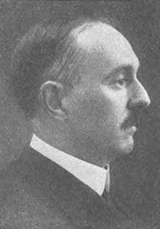
Public Health Defined
“The science and art of preventing disease, prolonging life, and promoting health through the organized efforts and informed choices of society, organizations, public and private communities, and individuals.”
—CEA Winslow
Photo: IF Fisher and EL Fisk
Winslow CEA. The untilled field of public health. Mod Med 1920;2:183–91.
5
Notes:
SAY:
Charles-Edward Armory Winslow is a leading figure in the development of the modern study of public health. His definition of public health, developed almost a century ago, is as follows:
“Public health is the science and art of preventing disease, prolonging life and promoting health through the organized efforts and informed choices of society, organizations, public and private communities, and individuals.”
Note the influences at the broader, societal, and community levels as well as the individual levels. You will see examples of public health at each of these levels throughout this course.
GO to next slide.

Slide 6


The Mission of Public Health
“Fulfilling society’s interest in assuring conditions in which people can be healthy.”
—Institute of Medicine
“Public health aims to provide maximum benefit for the largest number of people.”
—World Health Organization
6
Notes:
SAY:
The Institute of Medicine states that the mission of public health is fulfilling society’s interest in assuring conditions in which people can be healthy.
Similarly, the World Health Organization stresses that public health aims to provide maximum benefit for the largest number of people.
Public health focuses on groups of people, rather than just an individual. At the core of public health lies the principle of social justice, providing people the right to be healthy and to live in conditions that will support their health.
GO to next slide.

Slide 7
Public Health Key Terms
clinical care: prevention, treatment, and management of illness and the preservation of mental and physical well-being through the services offered by medical and allied health professions; also known as health care.
determinant: factor that contributes to the generation of a trait.
epidemic or outbreak: occurrence in a community or region of cases of an illness, specific health-related behavior, or other health-related event clearly in excess of normal expectancy. Both terms are used interchangeably; however, epidemic usually refers to a larger geographic distribution of illness or health-related events.
health outcome: result of a medical condition that directly affects the length or quality of a person’s life.
Stedman TL, ed. Stedman’s medical dictionary. 28th ed. Baltimore, MD: Lippincott, Williams, and Wilkins; 2006.
Farlex, Inc. The free dictionary. Huntingdon Valley, PA: Farlex, Inc.; 2014. Available at: http://www.thefreedictionary.com/.
7
Notes:
SAY:
Now that we know what public health is, let’s review some common key terms. Please locate the document titled “Public Health Key Terms” in your participant handout.
<READ the key terms from the handout and provide examples, if necessary.>
GO to next slide.

Slide 8

Knowledge Check
Fill in the blank with the correct answer.
A. groups of people
B. individuals
groups of people
Public health aims to provide ___________________ with the right to be healthy and live in conditions that support health.
8
Notes:
SAY:
Let’s review what we have learned about public health so far through a few knowledge check exercises.
<READ the knowledge check question and wait for participant responses.>
<CLICK for correct answer to appear.>
The correct answer is A, groups of people.
GO to next slide.

Slide 9
Knowledge Check
Fill in the blank with the correct answer.
A. pandemic
B. intervention
C. epidemic or outbreak
D. prevention
A(n) ________________________ is a disease occurrence among a population that is in excess of what is expected for a given time and place.
epidemic or outbreak
9
Notes:
<READ the knowledge check question and wait for participant responses.>
<CLICK for correct answer to appear.>
The correct answer is C, epidemic or outbreak.
GO to next slide.

Slide 10
Topic 2
The History of Public Health
10
Notes:
Topic 2
The History of Public Health
SAY:
Now, let’s review the history of public health. We will take a look at a few historical highlights through four lenses,
sanitation and environmental health,
pandemics,
disaster response and preparedness, and
prevention and policy.
GO to next slide.

Slide 11

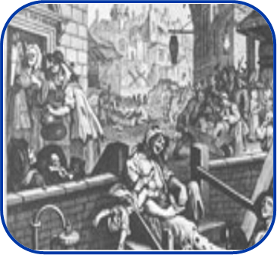

Sanitation and Environmental Health
500 BCE
1840s
1970
Greeks and Romans practice community sanitation measures
The Public Health Act of 1848 was established in the
United Kingdom
The Environmental Protection Agency was founded
11
Notes:
SAY:
The first lens we look through encompasses the control of disease and promotion of health through sanitation to ensure a healthy environment. Here are three examples of how public health has worked to contain infectious disease through environmental measures.
Around 500 BCE, the ancient Greeks and Romans actively practiced community sanitation measures.
Approximately 2 millennia later, the Public Health Act of 1848 was established. It provided a central board of health and placed responsibilities for sanitation in the hands of boroughs.
In 1970, the Nixon Administration established the Environmental Protection Agency, which protects human health by safeguarding air, water, and land.
GO to next slide.

Slide 12
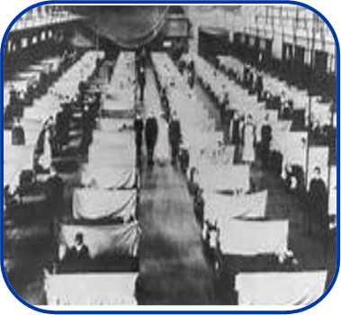
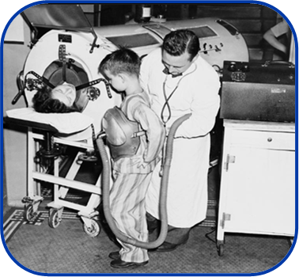

Pandemics
Influenza
Polio
HIV
500 million infected worldwide in 1918
Vaccine introduced in 1955; eradication initiative launched in 1988
34 million living with HIV worldwide; 20% decline in new infections since 2001
12
Notes:
SAY:
Next, we will explore pandemics. Pandemics are epidemics or outbreaks of disease that spread far and wide, affecting the populations of multiple continents.
Influenza, or the flu, has caused pandemics many times during both the distant past and recent history. Almost a century ago, the Spanish flu infected 500 million people across the world, including remote Pacific islands and the Arctic, killing 20 to 50 million persons. More recently, the influenza pandemic in 2009 infected persons in 214 countries, causing almost 19,000 confirmed deaths. Preparing for and controlling the effects of influenza will likely remain top priorities for public health.
Historically, polio was a common and highly feared disease that caused severe illness, including paralysis, and death among thousands of people each year. Thousands of people lined up to receive the polio vaccine after it was introduced in 1955. An initiative to eradicate polio was launched in 1988 because of outbreaks in more than 125 countries. Today, polio exists in only a few countries.
During the 1980s, human immunodeficiency virus, or HIV, emerged and spread rapidly across the globe. Public health has responded to this pandemic by developing new ways to diagnose and treat those who are infected. New infections of HIV are down 20% over the past 10 years, which is a sign that public health interventions are successful.
GO to next slide.

Slide 13
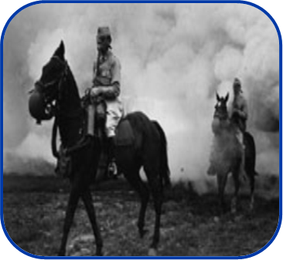
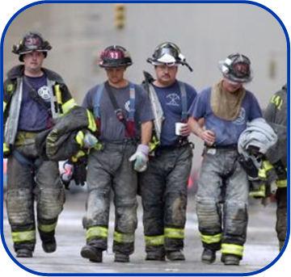
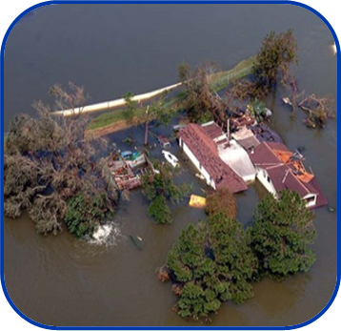
Preparedness for Disaster Response
Biologic Warfare
September 2001
Hurricane Katrina
Plague used as a weapon of war during the Siege of Kaffa
Public health surveillance conducted after the 9/11 attacks
Emergency services, public health surveillance, and disease treatment provided
13
Notes:
SAY:
The third area we’ll explore is public health’s role in preparedness and disaster response, both for natural disasters and human-made threats.
The use of biological warfare to infect people and animals goes back centuries. During the Siege of Kaffa in the 14th century AD, the attacking Tartar forces used plague as a weapon of war by hurling plague-infected corpses into the enemy’s city. Their actions started the first stage of the Black Death (or plague) among Europeans.
In the immediate wake of the terrorist attacks on September 11, 2001, public health workers were on the ground at the World Trade Center and the Pentagon, conducting surveillance to identify outbreaks of diseases or other possible health conditions resulting from the attacks. Public health workers closely monitored the health of first responders, city residents, and environmental conditions to detect health threats during the cleanup after the attack.
After Hurricane Katrina in 2005, public health workers and other disaster-relief agencies tirelessly provided emergency services. Teams were dispatched to conduct surveillance for illness and injury among people who evacuated to shelters and other places of refuge after the storm.
GO to next slide.

Slide 14

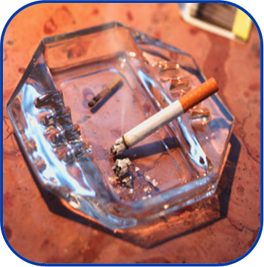

Prevention Through Policy
Book of Leviticus
Tobacco Laws
Obesity
The world’s first written health code
Laws banning smoking in public places
Food labeling and promotion of physical activity
14
Notes:
SAY:
The last lens we look through as we view public health history is prevention and policy. Public health works to protect and improve health, not just by responding to disease outbreaks or preparing for natural or human-made disasters, but also by implementing policies that support these efforts on a societal level.
As far back as 1500 BCE, Leviticus, the third book of the Hebrew Bible, is believed to be the first written health code in the world. The book deals with personal and community responsibilities and includes guidance regarding bodily cleanliness, sexual health behaviors, protection against contagious diseases, and isolation of lepers.
During 2000 to 2004, cigarette smoking was reported to be responsible for $193 billion dollars in annual health-related economic losses in the United States. Laws banning smoking in the workplace and other public places have been developed to encourage smokers to quit while protecting nonsmokers from the effects of second-hand smoke.
Finally, more than one-third of US adults and approximately 17% of children and adolescents aged 2 to 19 years are obese. Efforts to highlight fat, sugar, and salt content in foods through labeling regulations have been developed along with the promotion of physical activity in schools, workplaces, and neighborhoods. In New York City, the mayor and city council attempted to ban sodas larger than 16 ounces in an effort to combat the obesity epidemic.
GO to next slide.

Slide 15

Knowledge Check
Which of the following events in public health history have been pandemics? (Select all that apply)
A. Siege of Kaffa
B. Influenza
C. Polio
D. Hurricane Katrina
15
Notes:
<READ the knowledge check question and wait for participant responses.>
<CLICK for correct answers to appear.>
The correct answers are B, influenza and C, polio.
GO to next slide.

Slide 16

Topic 3
A Public Health Approach
16
Notes:
Topic 3
A Public Health Approach
GO to next slide.

Slide 17


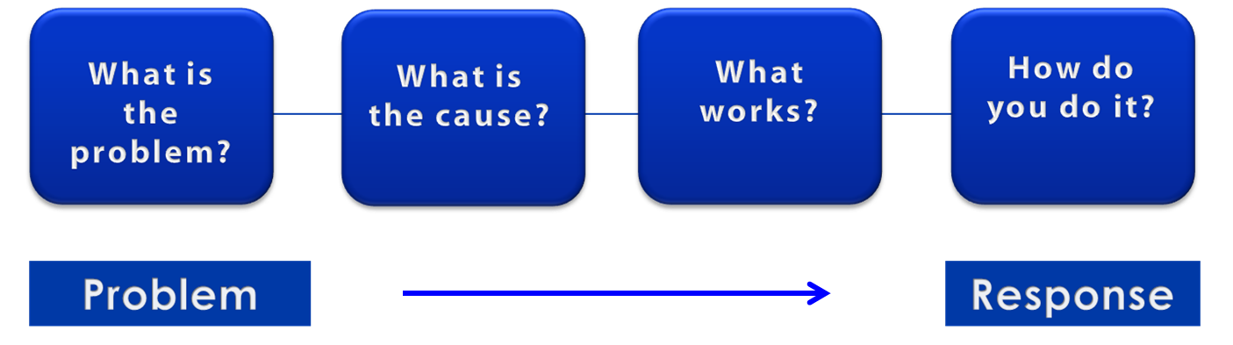
A Public Health Approach
Risk Factor Identification
Intervention
Evaluation
Surveillance
Implementation
17
Notes:
SAY:
Let’s talk about public health in a broader context. Public health problems are diverse and can include infectious diseases, chronic diseases, emergencies, injuries, environmental health problems, as well as other health threats.
Regardless of the topic, we take the same approach to a public health problem by following four general steps.
<CLICK for first arrow to appear.>
First, we ask “What is the problem?”
In public health, we identify the problem by using surveillance systems to monitor health events and behaviors occurring among a population.
After we’ve identified the problem, the next question is, “What is the cause of the problem?”
<CLICK to advance animation; first arrow will disappear, and second arrow will appear above Risk Factor Identification box.>
For example, are there factors that might make certain populations more susceptible to disease, such as something in the environment or certain behaviors that people are practicing?
<CLICK to advance animation; second arrow will disappear, and third arrow will appear above Intervention Evaluation box.>
Once we’ve identified the risk factors related to the problem, we ask, “What intervention works to address the problem?”
We look at what has worked in the past in addressing this same problem and if a proposed intervention makes sense with our affected population.
<CLICK to advance animation; third arrow will disappear, and fourth arrow will appear above Implementation box.>
In the last step, we ask, “How can we implement the intervention? Given the resources we have and what we know about the affected population, will this work?”
As we go through this course, you will see different examples of this public health approach at work.
GO to next slide.

Slide 18
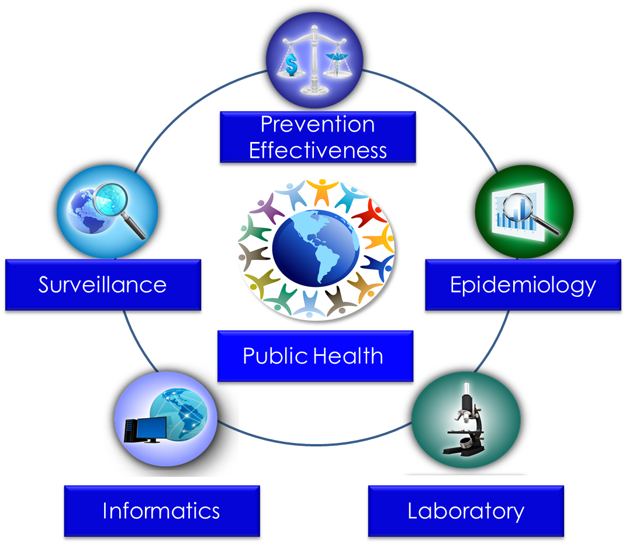
Public Health Core Sciences
Notes:
SAY:
To implement the public health approach, practitioners use and apply scientific methods. These methods come from a series of core sciences that provide the foundation.
These sciences include Public Health Surveillance, which we use to monitor a public health situation.
Epidemiology enables us to determine where diseases originate, how or why they move through populations, and how we can prevent them.
Public Health Laboratories support public health by performing tests to confirm disease diagnoses. Laboratories also support public health by conducting research and training.
As we continue to move from the use of paper documents to electronic health records, Public Health Informatics continues to increase in importance. Informatics deals with the methods for collecting, compiling, and presenting health information. It enables us to use electronic data effectively when addressing a public health situation.
Prevention Effectiveness is closely linked to public health policy. Prevention effectiveness studies provide important economic information for decision makers to help them choose the best option available.
Together, these five core sciences can help us protect and promote the public’s health by giving public health practitioners the answers they need. Public health is better able to respond to the situation by using contributions from each of these sciences. One science alone cannot answer the questions and provide a solution; it is the application of these core sciences together.
<OPTIONAL, IF YOU HAVE TIME, SAY>
For example, let’s look at the public health problem of influenza. Public health surveillance can monitor when and where cases of influenza occur each year. Professionals can use the science of epidemiology to understand why different populations choose to get vaccinated against influenza. They can use the science of informatics to receive and analyze electronic information from health care institutions (e.g., doctors’ offices and hospitals) to determine whether persons who get influenza go to see a doctor and whether they get well or die. Public health practitioners can use laboratory science to determine whether persons with fever and cough have influenza or a different infection, and they can use prevention effectiveness to show that influenza vaccination campaigns that might cost $200,000 can prevent $1 million in medical costs, lost wages, and other costs.
GO to next slide.

Slide 19
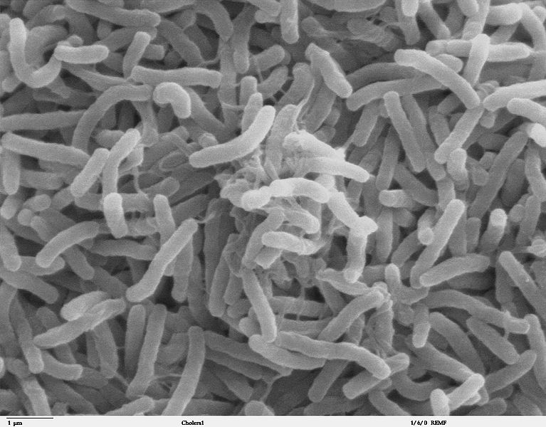
Cholera — A Public Health Approach
Cholera, a fatal intestinal disease, was rampant during the early 1800s in London, causing death to tens of thousands of people in the area. Cholera was commonly thought to be caused by bad air from rotting organic matter.
Photo: TJ Kirn, MJ Lafferty, CMP Sandoe, and R Taylor, Dartmouth Medical School
Notes:
SAY:
Let’s look at how the public health approach can be applied to an historical example of an infectious disease.
During the early 1800s in London, cholera, a fatal intestinal disease, was rampant, causing death to tens of thousands of people within hours of the first symptoms. At the time — which was before bacteria and viruses were recognized as the cause for many diseases — popular opinion held that cholera was caused by bad air coming from rotting organic matter.
GO to next slide.

Slide 20
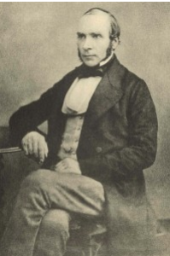
John Snow, Physician
John Snow is best known for his work tracing the source of the cholera outbreak and is considered the father of modern epidemiology.
Photo: London School of Hygiene and Tropical Medicine
Notes:
SAY:
John Snow, a British physician during that time, had a different opinion of cholera. He believed that the illness was spreading by way of a contaminated water supply because sewage was routinely dumped into the Thames River and cesspools near town wells. Because of his work tracing the source of the cholera outbreak, he is often considered the father of modern epidemiology. His research changed the way we look at disease.
GO to next slide.

Slide 21
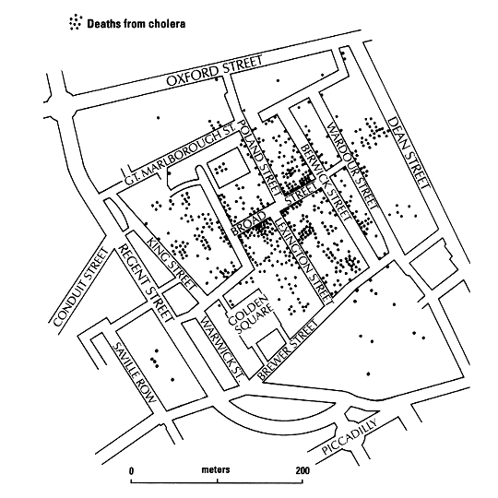
Epidemiology — What is the Problem?
Cluster of Cholera Cases, London — 1854
Image: The Geographical Journal
21
Notes:
SAY:
Now, let’s apply the public health approach to Snow’s research of the cholera outbreak.
What is the problem? Snow conducted public health surveillance by looking at where those with cholera lived in London. He saw that larger clusters of the cases were occurring in specific areas.
<CLICK for red circle to appear.>
SAY:
The red circle depicts the neighborhood in question, and the black dots represent the deaths from cholera. Notice the higher density of deaths around Broad Street.
Snow was assisted by a local clergyman, Reverend Henry Whitehead, in tracking down and interviewing cholera victims and their families and geographically mapping the outbreak. Their efforts highlight the benefits of linking scientific inquiry with engagement of community stakeholders and shared ownership for health.
GO to next slide.

Slide 22
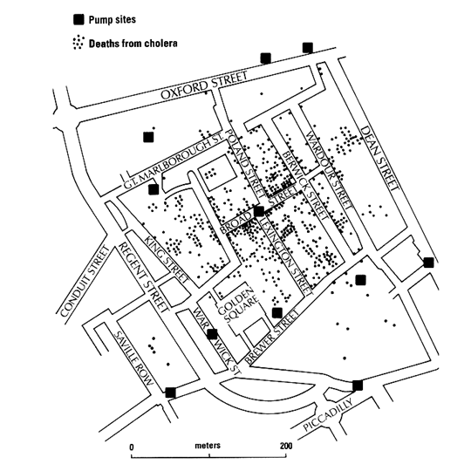
Risk Factor Identification — What Is the Cause?
Cluster of Cholera Cases and Pump Site Locations
Image: The Geographical Journal
Notes:
SAY:
Next he examined the data and tried to identify risk factors; that is, he tried to determine the cause of the deaths by using the pattern of where cases were occurring. This slide illustrates the location of the water pumps, which are indicated as black boxes.
On the basis of his previous work, Snow believed that water was a potential cholera source.
<CLICK for red boxes to appear.>
SAY:
The map reveals that the largest number of cholera cases occurred in areas near neighborhood water pumps. This observation prompted Snow to further research the distribution of water pumps in London. He identified where people who had cholera were drawing their water.
His findings indicated that clusters of cholera cases were more commonly located around certain pumps, particularly the Broad Street pump.
Through his research, Snow concluded that drawing water from the Broad Street pump was a primary risk factor for becoming ill with cholera.
GO to next slide.

Slide 23
Intervention Evaluation — What Works?
Through continuous research, Snow understood what interventions were required to
stop exposure to the contaminated water supply on a larger scale, and
stop exposure to the entire supply of contaminated water in the area
Notes:
SAY:
After identifying likely risk factors, the next step in the public health approach is evaluating potential interventions. What interventions will work? With the water supply from the Broad Street pump identified as the risk factor, Snow then worked to identify interventions to address the problem.
Through continuous research, Snow understood that the interventions required to control the cholera outbreak needed to
stop exposure to the contaminated water supply, and on a larger scale,
stop exposure to the entire supply of contaminated water in the area.
GO to next slide.

Slide 24

Implementation — How Do You Do It?
John Snow’s research convinced the British government that the source of cholera was water contaminated with sewage
Photo: Justin Cormack
Notes:
SAY:
Using the final step of the public health approach, Snow implemented the intervention by removing the handle from the Broad Street pump so no one could continue to draw water from the contaminated water supply.
After a long battle with the politicians and water companies, he finally convinced the British government that water contaminated with sewage was the source of cholera and other diseases, which resulted in the implementation of policies and laws for water sanitation.
GO to next slide.

Slide 25
Knowledge Check
Fill in the blanks with the correct answers.
Each public health core science helps us to ___________ and _________ the public’s health by providing public health practitioners with the answers they need.
protect
promote
25
Notes:
<READ the knowledge check question and wait for participant responses.>
<CLICK for correct answers to appear.>
The correct answers are protect and promote.
<ACCEPT participant answers that are approximately the same as the correct answers provided.>
GO to next slide.

Slide 26
Knowledge Check
Match each component of the public health approach with the questions they answer.
A. Risk Factor Identification
B. Surveillance
C. Implementation
D. Intervention Evaluation
B. Surveillance
What is the problem?
What is the cause?
What works?
How do you do it?
A. Risk Factor Identification
D. Intervention Evaluation
C. Implementation
Notes:
<READ the first knowledge check question and wait for participant responses.>
<CLICK for answer to appear.>
The correct answer is B, surveillance.
<READ the second knowledge check question and wait for participant responses.>
<CLICK for answer to appear.>
The correct answer is A, risk factor identification.
<READ the third knowledge check question and wait for participant responses.>
<CLICK for answer to appear.>
The correct answer is D, intervention evaluation.
<READ the fourth knowledge check question and wait for participant responses.>
<CLICK for answer to appear.>
The correct answer is C, implementation.
GO to next slide.

Slide 27

Topic 4
Core Functions and Essential Services
of Public Health
27
Notes:
Topic 4
Core Functions and Services of Public Health
SAY:
Now, let’s look at the core functions and services of public health.
GO to next slide.

Slide 28
Three Core Functions of Public Health
Systematically collect, analyze, and make available information on healthy communities
Assessment
Policy
Development
Promote the use of a scientific knowledge base in policy and decision making
Assurance
Ensure provision of services to those in need
Institute of Medicine. The future of public health. Washington, DC: National Academies Press; 1988.
28
Notes:
SAY:
In 1988, the Institute of Medicine defined three core functions of public health agencies that must be carried out at all levels of government for the overall public health system to work effectively.
<SUMMARIZE the screen by saying the following>
The three core functions are assessment, policy development, and assurance.
Assessment is knowing what needs to be done; policy development is being part of the solution to get it done; and assurance is making sure it gets done.
GO to next slide.

Slide 29
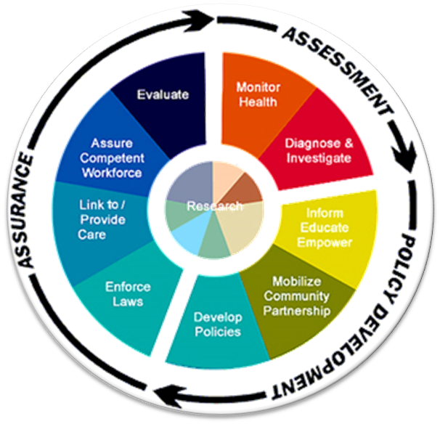
Ten Essential Public Health Services
Monitor Health
Diagnose and Investigate
Inform, Educate, Empower
Mobilize Community Partnership
Develop Policies
Enforce Laws
Link to/Provide Care
Assure a Competent Workforce
Evaluate
Research
Notes:
SAY:
Ten essential public health services are grouped under the three core functions. These services are not a prescription for what public health agencies should be doing. Instead, they are intended to serve as a descriptive tool to capture the field of public health and to communicate what public health provides.
Now, let’s think about how these essential services can be implemented. We’ll use tobacco use prevention as an example.
<ASK participants for examples of how each essential service can be used in tobacco use prevention.>
Possible answers are listed with each function.
1. Assessment
Monitor health status: Monitor smoking use among segments of the population, such as youth.
Diagnose and investigate health problems: Investigate risk factors associated with tobacco use.
2. Policy Development
Inform, educate, and empower people about health concerns: Place public service announcements on television regarding the dangers of smoking.
Mobilize community partnerships: Work with advocacy groups to develop antismoking interventions that will work in a specific community.
Develop policies and plans: Passage of Proposition 99 (the cigarette tax to fund antismoking campaigns); smoke-free workplaces, apartment complexes, and other shared spaces.
Assurance
Enforce laws and regulations: Enforcement of policies and laws, such as placement of cigarette vending machines.
Link people to needed personal health services: Address potential barriers related to culture and the language of materials, or staff serving special population groups. In California, ads in the tobacco control media campaign were broadcast in Spanish and Mandarin as well as English.
Assure a competent public health and personal health care workforce: Ensure a knowledgeable workforce is in place to develop and implement the antismoking campaign.
Evaluate effectiveness: Ongoing evaluation of the campaign to ensure it works as desired; determining how it might be improved.
Research for new innovative solutions to health programs: Take insights gained from the field on what works and confirm them through collaborative study with health researchers.
GO to next slide.

Slide 30
Core Functions at Government Levels
Policy
Development
Assessment
Assurance
Federal
National tobacco public health
surveillance
Smoking ban on commercial flights
Federal grants for antismoking
research
State
Monitor state
tobacco use
Increase
tobacco tax
Funding for campaign through
Proposition 99
Local
Report on local
tobacco use
County laws
prohibiting
smoking in bars
Resources to help
smokers quit in multiple languages
Notes:
SAY:
The core functions, assessment, policy development, and assurance must be carried out at all levels of government — federal, state, and local for the overall public health system to function effectively. Looking at tobacco use again, here are a few examples of each function at the different governmental levels.
<READ a few examples from the slide.>
GO to next slide.

Slide 31
Knowledge Check
Which of the following is NOT a core function of public health?
A. Assurance
B. Assessment
C. Authority
D. Policy development
31
Notes:
<READ the knowledge check question and wait for participant responses.>
<CLICK for correct answer to appear.>
The correct answer is C, authority.
GO to next slide.

Slide 32
Knowledge Check
The essential health services of monitoring health and diagnosing and investigating disease relate to which core public health function?
A. Assurance
B. Assessment
C. Policy Development
32
Notes:
<READ the knowledge check question and wait for participant responses.>
<CLICK for correct answer to appear.>
The correct answer is B, assessment.
GO to next slide.

Slide 33

Topic 5
Stakeholder Roles in Public Health
33
Notes:
Topic 5
Stakeholder Roles in Public Health
GO to next slide.

Slide 34
Partners in the Public Health System
Clinical Care Delivery System
Community
Government Public Health Infrastructure
Ensuring the Conditions for Population Health
Employers
and Businesses
Academia
The Media
Institute of Medicine. The future of the public's health in the 21st century. Washington, DC: The National Academies Press; 2002.
Notes:
SAY:
The field of public health is broad and interdisciplinary. Beyond government, it requires stakeholders with skills in intervention programs, policies, research, evaluation, and education.
Optional
<ASK, What other sectors and fields can you think of that have a stake in public health?>
Possible answers
Transportation, housing, schools, city planning, or law enforcement.
SAY:
Other partners include governments, community groups, clinical care, employers and businesses, the media, and academia, in addition to the infrastructure provided by government at all levels.
GO to next slide.

Slide 35
Nongovernmental Organization Examples
Organization Type | Example
Professional membership organizations | American Public Health Association
Associations related to a specific health concern | American Cancer Society
Organizations of citizens focused on health concerns | Americans for Nonsmokers Rights
Foundations that support health projects and influence public policy development | Bill and Melinda Gates Foundation
Institute of Medicine. Who will keep the public healthy? Workshop summary. Washington, DC: The National Academies Press; 2003.
35
Notes:
SAY:
Nongovernmental organizations (often referred to as “NGOs”) play a key role in public health, especially at the community level. NGOs serve many different purposes from advocacy or education to emergency relief and economic development. General types of NGOs include
professional membership organizations, such as the American Public Health Organization;
organizations that focus on a specific health problem, such as the American Cancer Society;
citizen groups, such as Americans for Nonsmokers’ Rights; and
foundations that support health projects and work at the policy level, such as CARE, which fights global poverty, and the Bill and Melinda Gates Foundation, which funds public health projects around the world.
GO to next slide.

Slide 36
Health Care as a Partner in Public Health
Public Health | Health Care
Population focus | Individual patient focus
Public health ethic | Personal service ethic
Prevention or public health emphasis | Diagnosis and treatment emphasis
Joint laboratory and field involvement | Joint laboratory and patient involvement
Clinical sciences peripheral to professional training | Clinical sciences essential to professional training
Public sector basis | Private sector basis
Notes:
SAY:
Health care plays a vital role in protecting and promoting the public’s health along with public health organizations. The two have differences that are worth highlighting here. Public health focuses on populations, while clinical care focuses on the individual patient.
<DISCUSS a few examples from the table.>
Health care and public health are complementary. When they work collaboratively, all people benefit.
GO to next slide.

Slide 37
Other Partners in Public Health
Vehicle for public discourse
Health education and promotion
Health communication
Social media as catalyst
Media
Employer-sponsored health insurance programs
Wellness initiatives and benefits
Healthy workplaces and communities
Employers and Businesses
Government Agencies
City planning
Education
Health in all policies
Education
Training
Research
Public Service
Academia
Notes:
SAY:
Here are some of the other primary partners in public health.
Increasingly, social media serves as a vehicle for the public’s discourse on public health concerns, and historically, public health agencies and other partners have educated the public and promoted healthy behaviors through the news and entertainment media.
Employers and businesses contribute to the public’s health by providing health insurance, for example. Workplaces also have wellness initiatives, such as gym subsidies that promote the health of their employees.
Government agencies, such as CDC, work in partnership with state, local, and tribal health departments. However, important contributions are made by other government agencies at all levels. City planning departments can include sidewalks and bike paths to promote and support safe ways to exercise. Education departments can include public health messages for students, implement prevention in school health programs, and work to ensure healthy food options at school. Similarly, many other government agencies can work as partners in public health by including health considerations in their policy development.
Academia educates and trains the public health workforce, such as scientists, epidemiologists, and informaticians. Additionally, research conducted in academia is put to use in the larger communities around the US and the world.
GO to next slide.

Slide 38
Knowledge Check
Match each stakeholder to its role in public health.
A. Academia
B. Employers and businesses
C. Government
D. Media
D. Media
1. Vehicle for public discourse
C. Government
2. Health in all policies
A. Academia
3. Education and training
B. Employers and businesses
4. Wellness initiatives and benefits
38
Notes:
<READ the first knowledge check question and wait for participant responses.>
<CLICK for answer to appear.>
The correct answer is D, media.
<READ the second knowledge check question and wait for participant responses.>
<CLICK for answer to appear.>
The correct answer is C, government.
<READ the third knowledge check question and wait for participant responses.>
<CLICK for answer to appear.>
The correct answer is A, academia.
<READ the fourth knowledge check question and wait for participant responses.>
<CLICK for answer to appear.>
The correct answer is B, employers and businesses.
GO to next slide.

Slide 39

Topic 6
Determining and Influencing the Public’s Health
39
Notes:
Topic 6
Determining and Influencing the Public’s Health
GO to next slide.

Slide 40

Health Determinants
Genes and biology
Health behaviors
Social or societal characteristics
Health services or medical care
40
Centers for Disease Control and Prevention. Social determinants of health. http://www.cdc.gov/socialdeterminants/FAQ.html.
Notes:
SAY:
As we discussed previously in the course, certain factors determine a person's state of health. Scientists generally recognize these health determinants for any population.
Take a minute to read them.
<ASK the following question.>
What are some specific examples of each type of health determinants?
Possible answers:
Genes and biology: sex, age, genetic makeup.
Health behaviors: smoking, eating habits, physical activity.
Social/societal characteristics, including the total ecology: discrimination because of income or sex. where a person lives, including especially air, water, and sanitation quality.
Medical care: quality health care, insurance coverage.
Other answers: level of education achieved, immunity levels, income level, parenting, race/ethnicity, quality of the surrounding built environment, quality of schools, and ability to work.
GO to next slide.

Slide 41
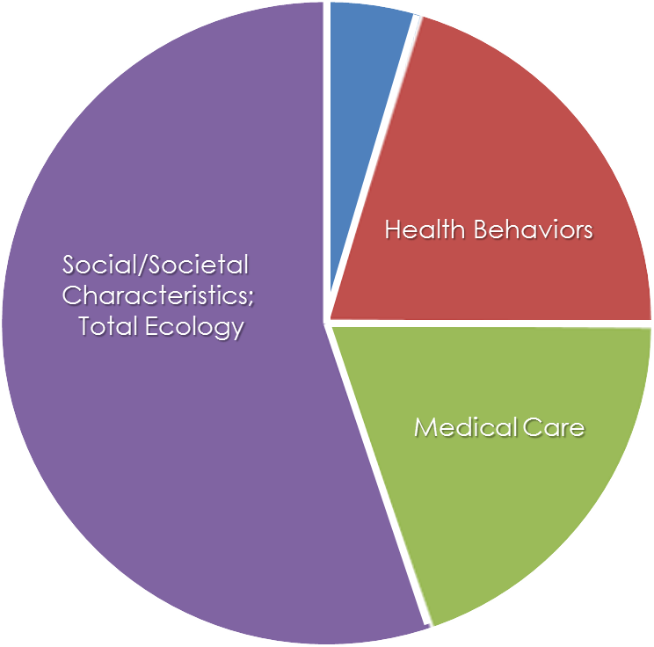
What Determines the Health of a Population?
Genes and Biology
Social/Societal
Characteristics;
Total Ecology
Health Behaviors
Medical Care
41
Centers for Disease Control and Prevention. Social determinants of health. http://www.cdc.gov/socialdeterminants/FAQ.html.
Notes:
SAY:
This chart is an estimate of how these four major determinants influence health at the population level.
Notice the portion of the chart that represents medical care. We spend trillions of dollars on health care, yet it only determines about 25% of our health. The remaining 75% of what determines our health as a population is our total environment or ecology, including the social environment in which we live, plus our health behaviors and to a lesser extent, our genes and biology.
An example of the role these determinants play in our daily lives is through nutrition and physical activity. Both are essential elements in producing optimal health and should be viewed in the context of such environmental factors as
social and cultural norms that influence food choices and physical activity,
environmental characteristics, such as availability (lack of healthy food, open space for exercise, or safety in urban neighborhoods), and
sector influences, such as the marketing of processed food.
All of these factors influence our individual choices, which in turn, influence our overall health.
GO to next slide.

Slide 42
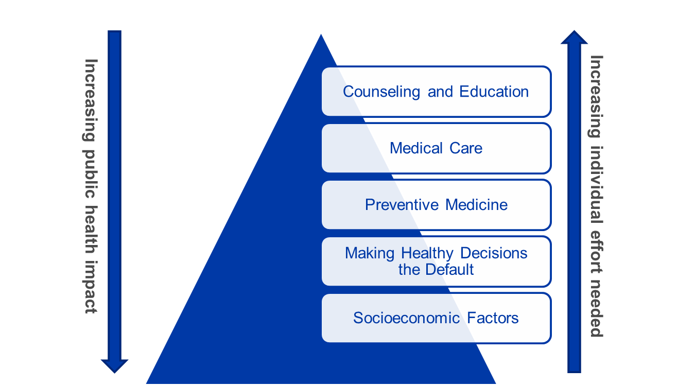
Health Impact Pyramid
42
Frieden TR. Framework for public health action: the health impact pyramid. Am J Public Health 2010;100:590–5.
Notes:
SAY:
To address the determinants on the slide we just discussed, we have to have a plan of attack or a means to affect change. This pyramid describes such a plan — the impact of different types of public health interventions.
<CLICK to advance animation; arrow on left will appear.>
As we move down the pyramid, the public health impact grows greater. However,
<CLICK to advance animation; arrow on right will appear.>
As we move up the pyramid, the amount of individual effort increases.
Starting at the top, we can do counseling and education, perform clinical interventions, have longer lasting preventive interventions, change the context in which people operate so the default decisions they make are healthy, and lastly, positively influence socioeconomic factors.
A point to emphasize here is that we have to have tradeoffs. We have to sometimes give up resources in one area to have a larger impact in another.
Let’s take a look at some examples.
GO to next slide.

Slide 43
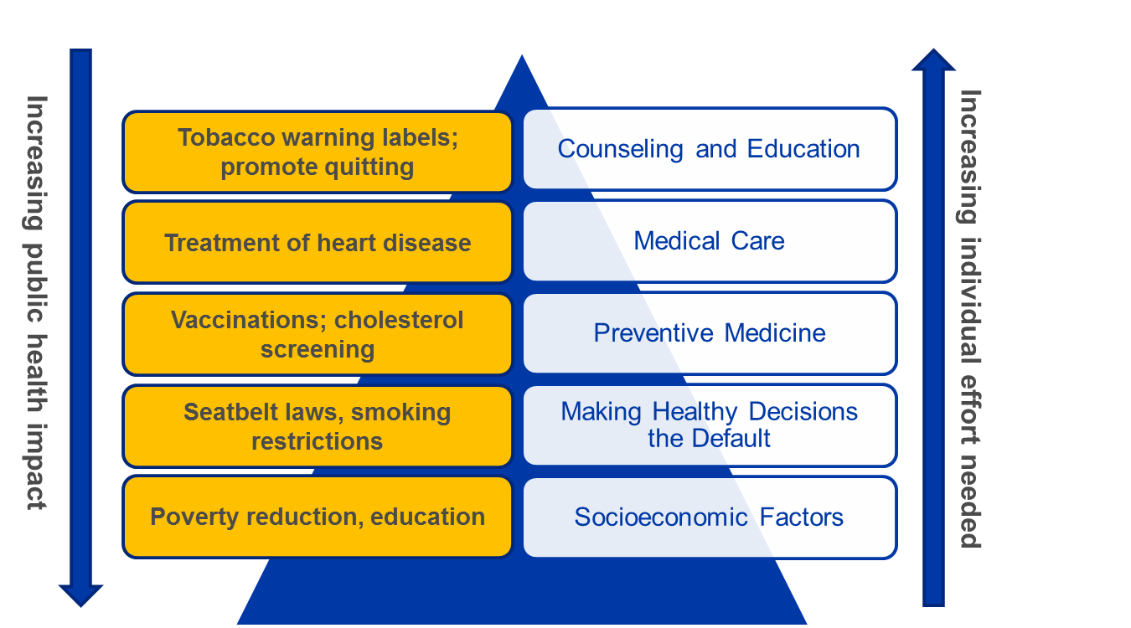
Health Impact Pyramid
43
Frieden TR. Framework for public health action: the health impact pyramid. Am J Public Health 2010;100:590–5.
Notes:
SAY:
This pyramid illustrates the impact of different types of public health interventions. Let’s start at the top of the pyramid and work down.
<CLICK to advance animation; text box will appear.>
Counseling and education (in clinical and other settings) is regarded by some as the essence of public health action, but unfortunately, it is not as effective as we would like. That being said, at times, counseling and education are the only forms of intervention available and, when applied consistently and repeatedly, can have an impact. Examples include warning labels on cigarette packs and campaigns to promote tobacco cessation.
<CLICK to advance animation; text box will appear.>
Moving to clinical interventions, ongoing medical care for a health condition is an example. In the case of cardiovascular disease, these interventions can have a considerable effect. However, we are limited by a lack of access to certain patients who need care and lack of adherence to medical instructions in the real world.
<CLICK to advance animation; text box will appear.>
Long-lasting preventive medicine interventions, vaccines for example, prevent 2.5 million deaths among children around the world every year. In this case, a single dose or instance of an intervention can have a life-long effect.
<CLICK to advance animation; text box will appear.>
We make health decisions the default by changing the context in which behaviors occur, making it difficult to avoid the intervention. For example, changing the laws to require seat belt use in cars and banning smoking in certain public places have had substantial impact.
<CLICK to advance animation; text box will appear.>
At the base of the pyramid are public health interventions that affect socioeconomic factors. If we can improve quality of life by helping people out of poverty, providing basic sanitation, improving their access to education, healthy food, and medical care, we can greatly improve a population’s chances for a healthy life.
GO to next slide.

Slide 44
Knowledge Check
List the four determinants of health.
1.
2.
3.
4.
Genes and biology
Health behaviors
Social/societal characteristics
Health services or medical care
44
Notes:
<READ the knowledge check question and wait for participant responses.>
<CLICK for correct answers to appear.>
The correct answers are
Genes and biology
Health behaviors
Social/societal characteristics (total ecology)
Health services or medical care
GO to next slide.

Slide 45
Knowledge Check
Fill in the blanks using the following choices.
A. down
B. up
1.
down
As we move the health impact pyramid, the public health impact grows greater.
2.
up
As we move the health impact pyramid, the amount of individual effort increases.
45
Notes:
<READ the knowledge check question and wait for participant responses.>
<CLICK for correct answers to appear.>
The correct answers are (1) A, down and (2) B, up.
GO to next slide.

Slide 46
Public Health Core Sciences
Notes:
SAY:
Within each of the topics we have covered in this course, underlying all of our actions and decisions is the application of the public health core sciences.
I encourage you to build on what you have learned in this course by learning more about how these core sciences contribute to public health by taking the introductory courses offered in this Public Health 101 series in
prevention effectiveness,
epidemiology,
laboratory,
informatics, and
surveillance.
GO to next slide.

Slide 47
Course Summary
During this course, you learned to
describe the purpose of public health
define key terms used in public health
identify prominent events in the history of public health
recognize the core public health functions and services
describe the role of different stakeholders in the field of public health
list some determinants of health
recognize how individual determinants of health affect population health
47
Notes:
SAY:
Let’s review the learning objectives for this session.
<READ the objectives listed on the slide.>
GO to next slide.

Slide 48
QUESTIONS?
Notes:
GO to next slide.

Slide 49
Resources and Additional Reading
American public health Association (APHA). The Prevention and public health Fund: a critical investment in our nation’s physical and fiscal health. APHA Center for Health Policy Issue Brief. Washington, DC: APHA; 2012. http://www.apha.org/NR/rdonlyres/8FA13774-AA47-43F2-838B-1B0757D111C6/0/APHA_PrevFundBrief_June2012.pdf.
California Department of public health. TabaccoFreeCA. http://www.Tobaccofreeca.org.
Centers for Disease Control and Prevention. Key facts about seasonal flu vaccine. http://www.cdc.gov/flu/protect/keyfacts.htm.
Centers for Disease Control and Prevention. Overweight and obesity. http://www.cdc.gov/obesity/index.html.
Centers for Disease Control and Prevention. Social determinants of health. http://www.cdc.gov/socialdeterminants/FAQ.html.
Centers for Medicare and Medicaid Services. National health expenditure projections: 2008–2018. http://www.cms.gov/Research-Statistics-Data-and-Systems/Statistics-Trends-and-Reports/NationalHealthExpendData/downloads/proj2008.pdf.
Dean H. Introduction to public health, epidemiology, and surveillance. Presented at the CDC Science Ambassador Program, July 16, 2012.
Frieden, TR. Framework for public health action: the health impact pyramid. Am J public health 2010;100:590–5.
Kindig D, Stoddart G. What is population health? Am J public health. 2003;93:380–3.
Institute of Medicine. For the public’s health: investing in a healthier future. Washington, DC: National Academies Press; 2012.
Institute of Medicine. Primary care and public health: exploring integration to improve population health. Washington, DC: The National Academies Press; 2012.
49
Notes:
SAY:
The information from this course is based on these resources; I encourage you to take a look at them after this course.
GO to next slide.

Slide 50
Resources and Additional Reading
Institute of Medicine. The future of public health. Washington, DC: The National Academies Press; 1988.
Institute of Medicine. The future of the public's health in the 21st century. Washington, DC: The National Academies Press; 2002.
Institute of Medicine. Who will keep the public healthy? Workshop summary. Washington, DC: The National Academies Press; 2003.
Pearl R. Tobacco smoking and longevity. Science 1938;87:216–7.
Preamble to the Constitution of the World Health Organization as adopted by the International Health Conference, New York, June19–July 22, 1946.
Federal Communications Commission. Texting while driving. http://www.fcc.gov/guides/texting-while-driving.
UNAIDS. UNAIDS World AIDS Day Report, 2012. http://www.unaids.org/en/media/unaids/contentassets/ documents/epidemiology/2012/gr2012/JC2434_WorldAIDSday_results_en.pdf.
Skelton A. Introduction to public health science and practice.” Presented at the CDC Steven M. Teutsch Prevention Effectiveness Fellowship Orientation, August 15, 2012.
US Department of Health, Education, and Welfare. Smoking and health. Washington, DC: public health Service; 1964. http://profiles.nlm.nih.gov/ps/access/NNBBMQ.pdf.
Winslow CEA. The untilled field of public health. Mod Med 1920;2:183–91.
World Health Organization (WHO). World report on violence and health. Geneva: WHO; 2002. http://www.who.int/violence_injury_prevention/violence/world_report/en/.
50
Notes:
GO to next slide.

Slide 51
Disclaimers
Links provided in this course to nonfederal organizations are provided solely as a service to our users. These links do not constitute an endorsement of these organizations nor their programs by the Centers for Disease Control and Prevention (CDC) or the federal government, and none should be inferred. CDC is not responsible for the content contained at these sites.
Use of trade names and commercial sources is for identification only and does not imply endorsement by the Division of Scientific Education and Professional Development, Center for Surveillance, Epidemiology, and Laboratory Services, Centers for Disease Control and Prevention, the Public Health Service, or the U.S. Department of Health and Human Services.
The findings and conclusions in this course are those of the authors and do not necessarily represent the official position of the Centers for Disease Control and Prevention.
51
Notes:
Go to next slide.

Slide 52
For more information, please contact the Centers for Disease Control and Prevention
1600 Clifton Road NE, Atlanta, GA 30333
Telephone: 1-800-CDC-INFO (232-4636)/TTY: 1-888-232-6348
Visit: http://www.cdc.gov | Contact CDC at: 1-800-CDC-INFO or http://www.cdc.gov/info
The findings and conclusions in this course are those of the authors and do not necessarily represent the official position of the Centers for Disease Control and Prevention.
Center for Surveillance, Epidemiology, and Laboratory Services
Division of Scientific Education and Professional Development

